Slide 1
The Constitution of the United States

Slide 2
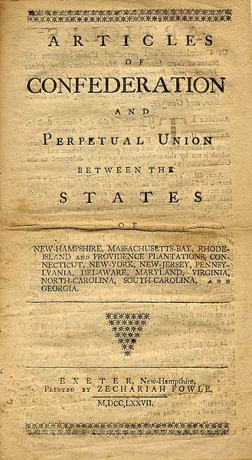
Aiming for a more perfect union
Or at least a less bad one.
The “Articles of Confederation and Perpetual Union” drafted during the revolution.
Very weak:
No executive, no courts, and no power of enforcement.
No power of taxation, only petition.
Required 9/13 (69%!) agreement for legislation
Unanimity for changes!
Government meets in Annapolis in 1786, decides to meet in Philadelphia in 1787 to fix things.

Slide 3
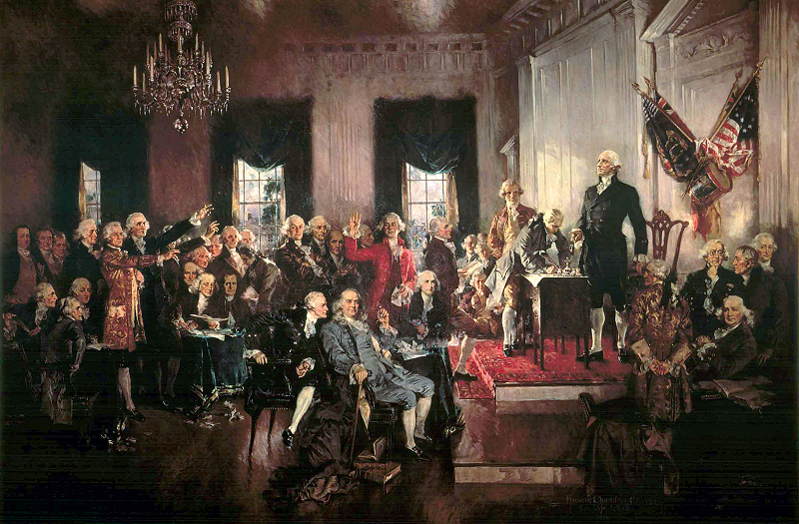
Philadelphia Convention
Many ideas are proposed and debated.
Two plans eventually come to the fore.
Virginia’s Plan
New Jersey’s Plan
The “Large State” Plan
Proposed by James Madison
A Totally New System
Bicameral Legislature
Both houses apportioned by population
Executive chosen by Lower House
Upper House chosen by Lower House
“Small State” Plan
In response to Madison’s plan
A Revision of the Articles
Unicameral Legislature
One state, One Vote
New Powers
Taxation
Enforcement
Multi-Person Executive (picked by Congress)

Slide 4
A Compromise from connecticut
The idea is proposed of a bicameral legislature: an upper house where each state has equal influence, and a lower house where each state has influence based on population.
Bicameral Legislature
Upper House (Senate)
Every state gets two members.
Chosen by state legislatures.
(this will change… eventually)
Lower House (of Representatives)
Apportioned by Population
Chosen by direct election
States with large slave populations want slaves counted for population
But not for taxation!
(Who is surprised, really?)
3/5^{ths} Compromise: 5 Slaves = 3 People
“Population” becomes a point of contention among slaveholding states.

