Slide 1
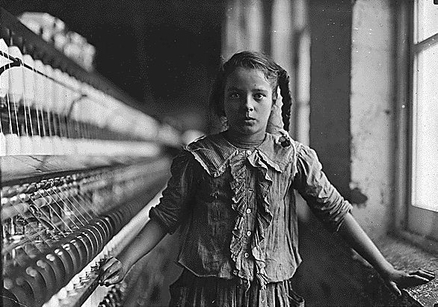
The Industrial World
The United States after the Civil War

Slide 2
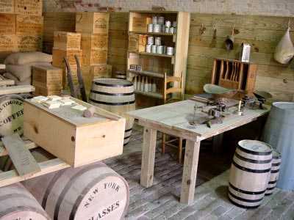
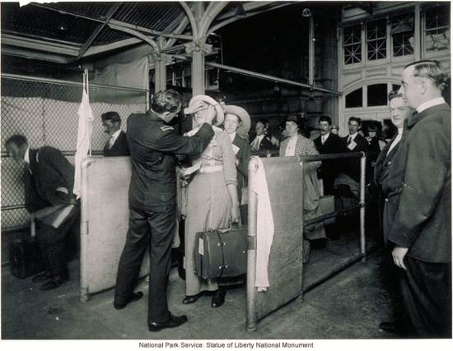
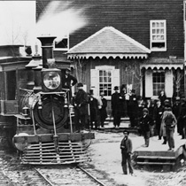
Civil War increases industrial demand.
Spurs production innovation.
Increased food production and transport
Large Expansion of Railroads
Encourage Immigration to the US

Slide 3
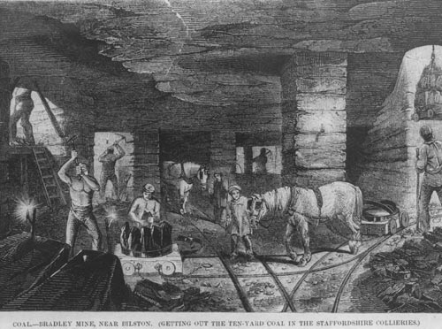
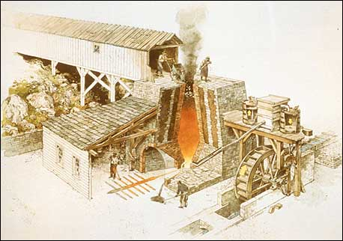
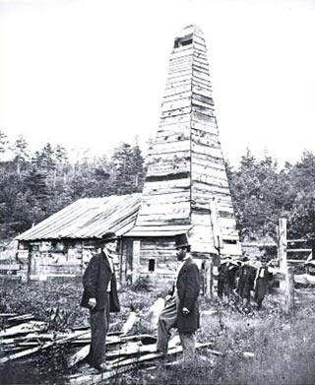
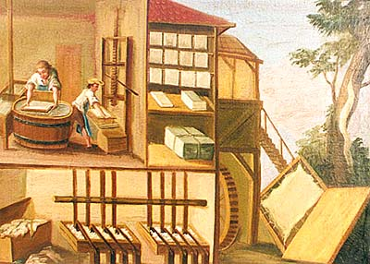
Iron and Coal
The United States possesses great amounts of key natural resources:
Timber
Coal
Iron Ore
(Later) Oil

Slide 4
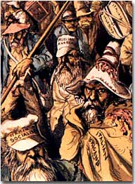
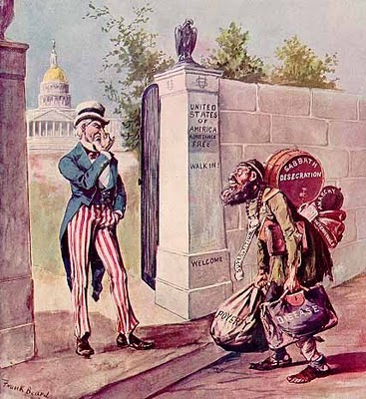
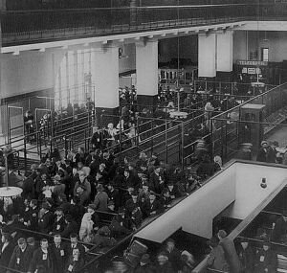
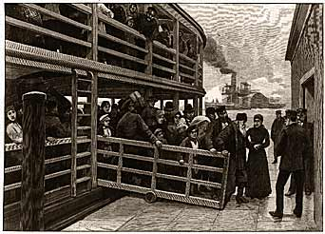
Immigration
Many Immigrants come to the United States, eventually up to one million per year. (US Pop in 1900 : ~76 Million)
Often political and economic refugees
Attracted to political & economic opportunities
Willing to work for low wages
Willing to move to find work
Immigrant Backlash

Slide 5
Immigration
Immigrants come from all over the world.
Eastern United States:
Ireland Eastern Europe
Southern Europe
Western United States:
Asia (Mostly China)

Slide 6
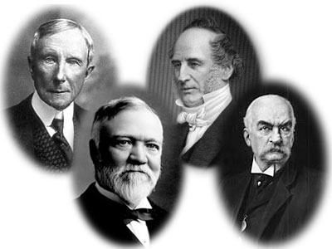
Growth of Lassez-Faire Capitalism
Capitalism (aka “Free Enterprise”)
- Where individuals, not the government, own and operate most businesses.
Entrepreneurs
- Someone who creates a business
Some will be able to create monopolies and become Robber Barons
John D. Rockefeller – Standard Oil
Andrew Carnegie – US Steel
Cornelius Vanderbilt - Railroads
JP Morgan - Banking

Slide 7
Lassez-Faire
The idea that the government should stay out of regulating business and industry
Government more than willing to help industries develop:
> Railroads given free land
> Enacted protective tariffs (tax on imported goods)

Slide 8
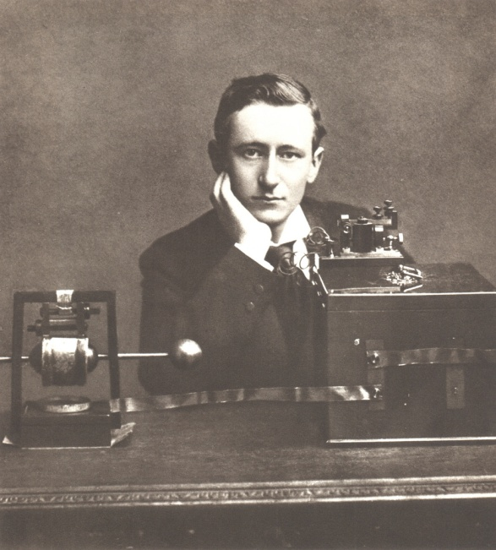
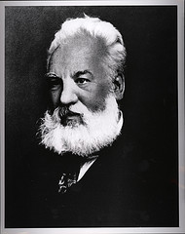
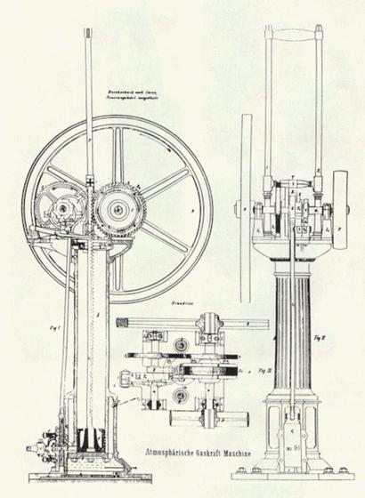
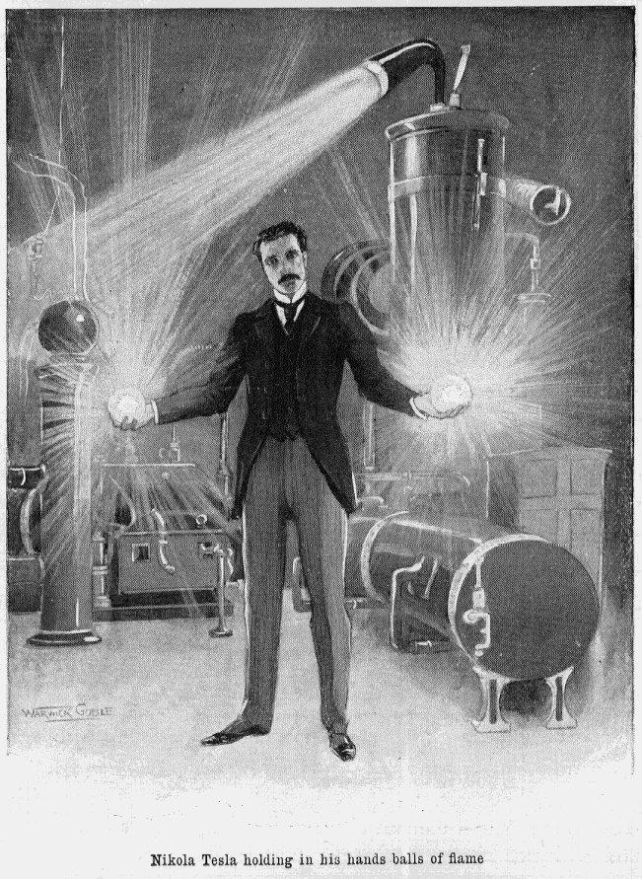
An Era of Innovation
Desire for increases in production and efficiency lead to the myth of the heroic inventor!
Inventions may be protected by patents, and so inventions become big business!

Slide 9
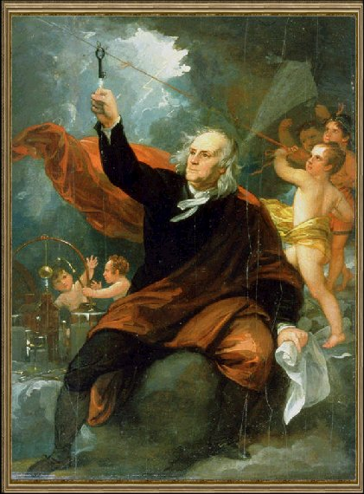
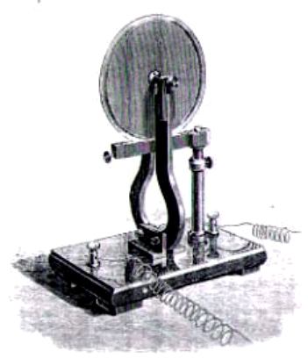
Electricity – The Lifeblood of Industry
Serious study of electricity begins in the 1600s, and remains mainly a curiosity through the 1700s.
1821: Electric Motor

Slide 10
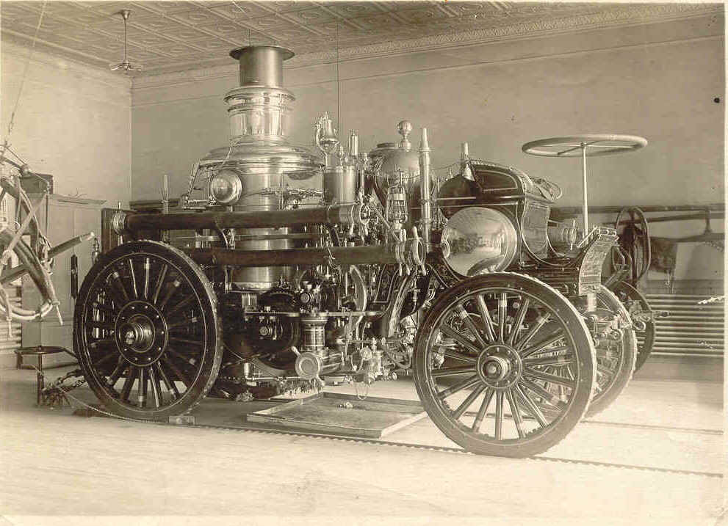
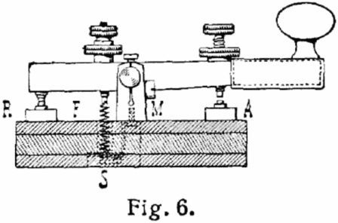
Electricity – The Lifeblood of Industry
Electric motors, circuits, and engines power a new world!
Communication
Transportation
Entertainment

Slide 11
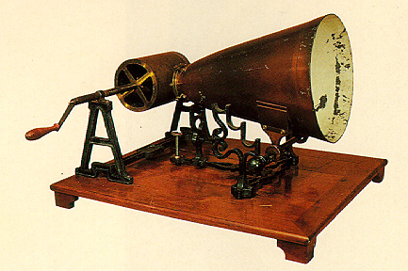
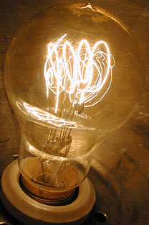
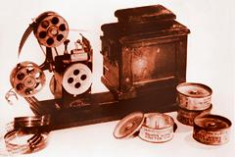
The Wizard of Menlo Park
Thomas Edison is best known for one thing. . .
Although he is responsible for many more inventions, including the phonograph (record player) and moving pictures (movies)

Slide 12
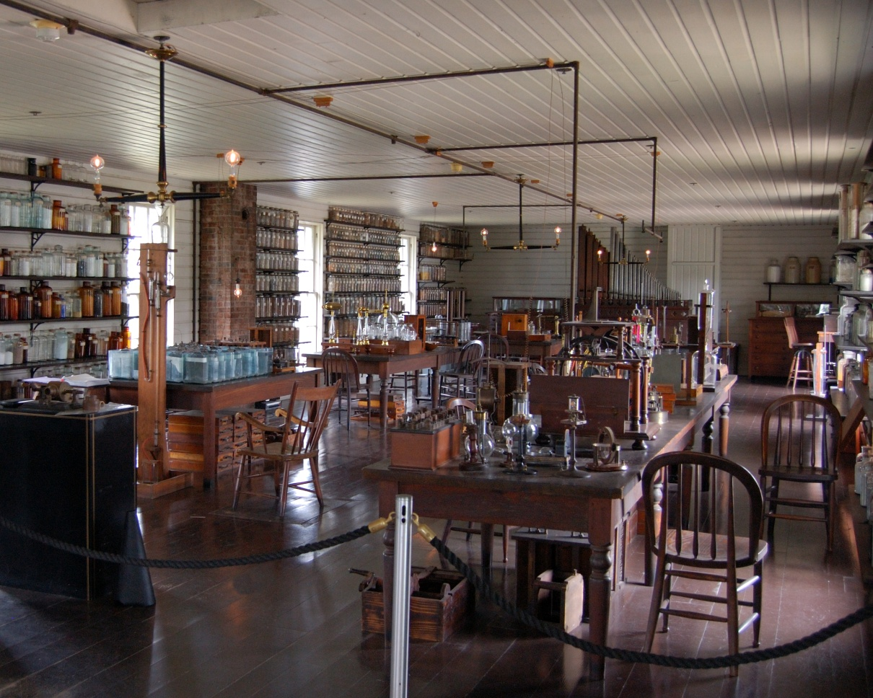
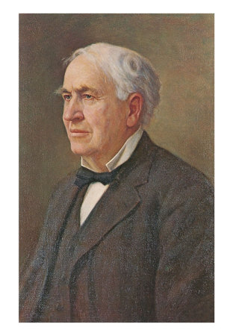
The Wizard of Menlo Park
Best Invention?
An Idea.
The Research and Development (R&D) Laboratory
Menlo Park, New Jersey

Slide 13
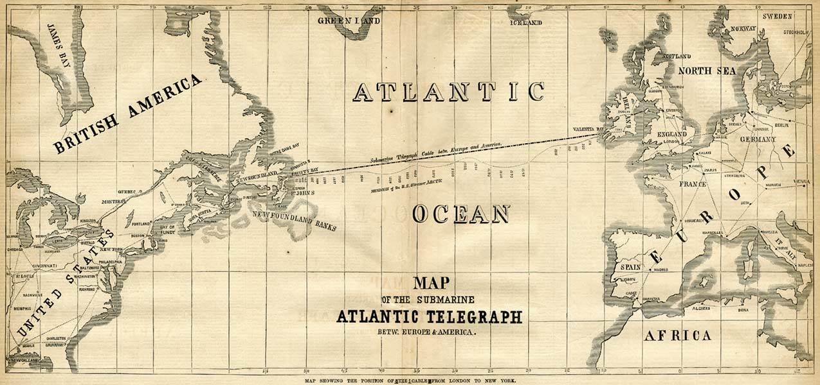
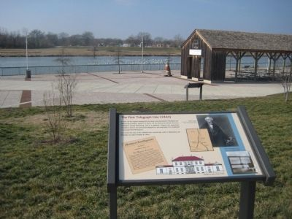
“What Hath God Wrought?”
1844 – First Telegraph Line Completed
By the 1860s, Telegraphs connect most major cities, and even Europe!

Slide 14
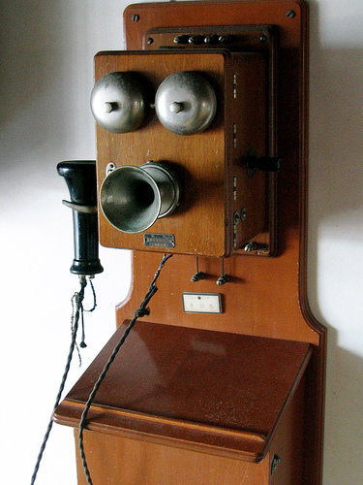
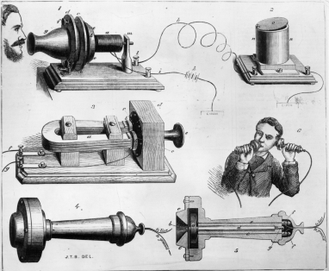
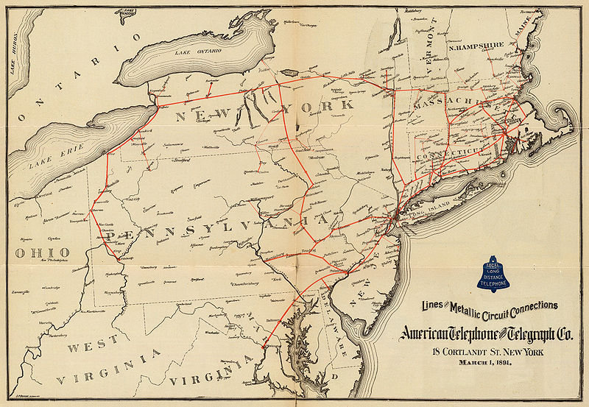
“Hello?”
1876 – Alexander Graham Bell patents Telephone
Founds The American Telephone and Telegraph Company (AT&T)
By 1900, over one million telephones!

Slide 15
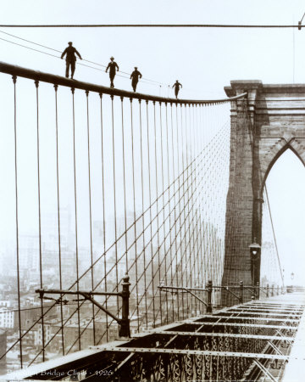
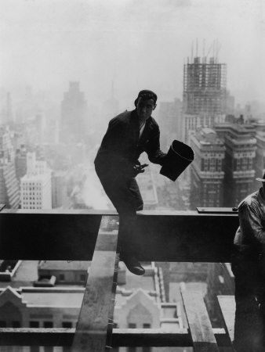
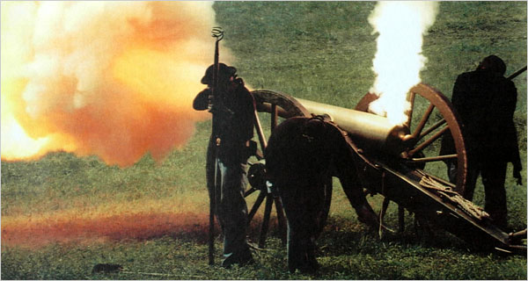
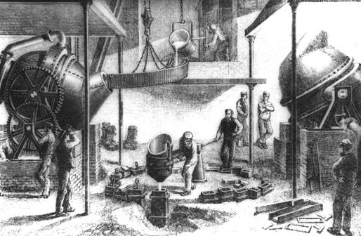
Steel
1850s – Henry Bessemer in England develops a method for easily making steel.
Cheap steel leads to skyscrapers, suspension bridges, and more powerful weapons of war!

Slide 16
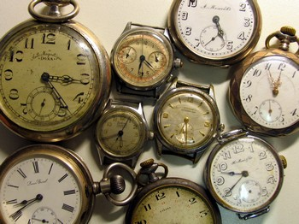
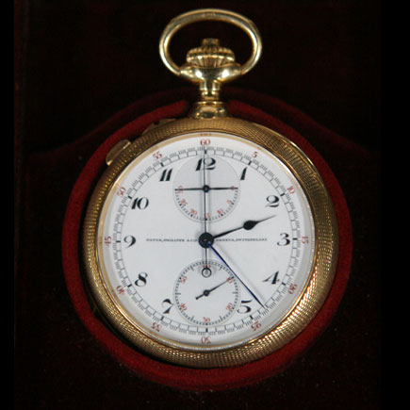
The Arrival of Time
No “standard” time. Everyone keeps their own local time.
But not everyone’s clocks agree, and this causes problems.

Slide 17
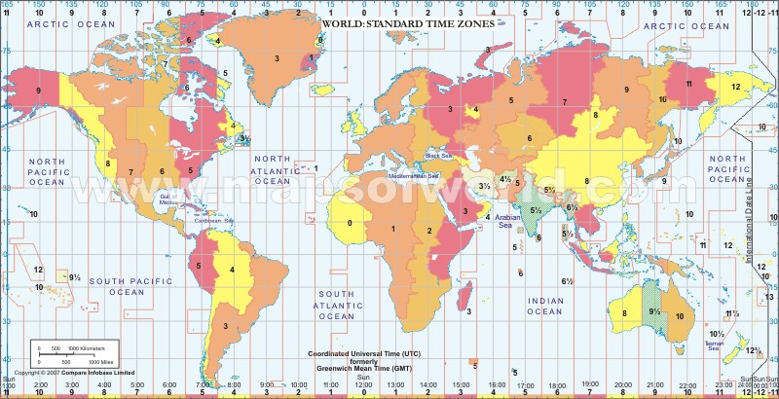
The Arrival of Time
In 1884, a group of 24 countries come together to create time zones.
With everyone agreeing what time it is, things run much more smoothly!

Slide 18
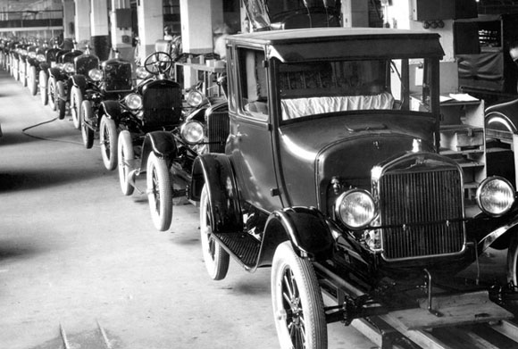
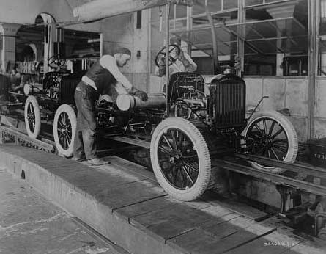
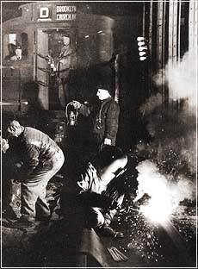
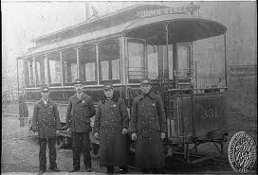
Light Rail and the Automobile
Cities with large populations begin to build subways and streetcars.
1908, the first automobile assembly lines begin turning out cars.
By 1925, Ford produces 2 million Model-Ts per year!

Slide 19
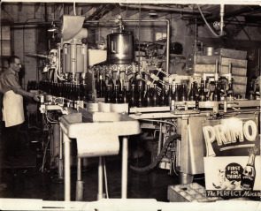
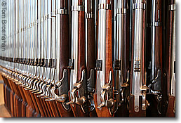
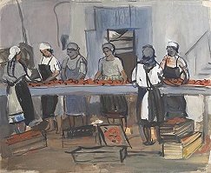
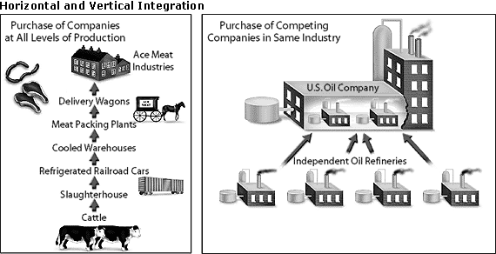
Force Multipliers
Each advance and innovation makes every step of production more efficient.
Eventually, increases in efficiency and demand lead to a system of mass production in almost every industry!

Slide 20
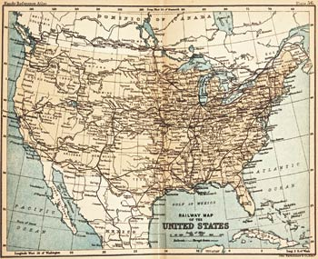
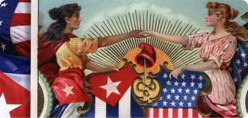
The Modern World
(for better and for worse)
America the Economic Juggernaut
More miles of railroad than the rest of the world combined
Dominates Markets (Grain, Steel, Manufactured Goods)
Global Trade, Global Problems

Slide 21
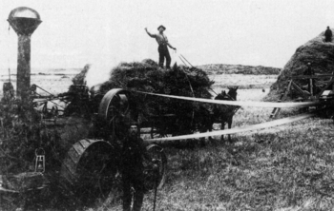
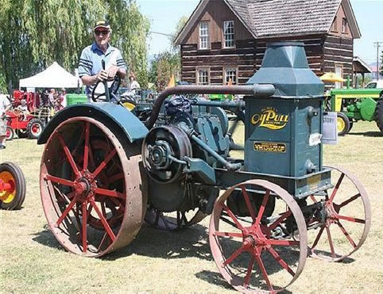
The Modern World
(for better and for worse)
America the Urban
Machines decrease demand for farm labor
Unskilled workers flood cities
Americans Enter the Wage Economy

Slide 22
The Modern World
(for better and for worse)
America the Environmental Horror Show
Few considered environmental impact
Industrial waste in water and air
Farming methods harm soil
Erosion and Dust Storms
Concerns about environment lead to National Park Service.
Yellowstone Park (1872)

Slide 23
Labor vs. Capital
A New Conflict For A New Age

